Slide 1
CSE428
Milestone 2
Presentation
Istiak Ahmed (21241066)
Md Fahim Faisal (19101161)
Mahir Faisal Chowdhury (19301026)
Md Sadi Ashraf (23141067)
Sk Samiul Kadir (20101211)
Md.Waseq Alvi (20101153)

Slide 2
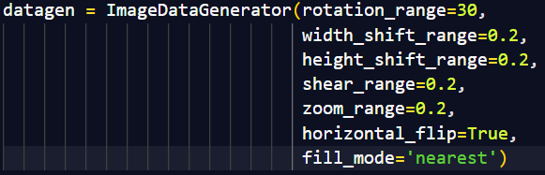
Augmentation
Random Rotations
Horizontal and Vertical Shifts
Shear Transformations
Random Zooming (Zoom in, Zoom out)
Random Horizontal Flips
Types of Augmentation

Slide 3
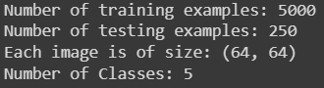
Dataset
Classes : Flagpole, Gondola, Glass Mask, Hourglass, Lampshades
Data Points in Train and Test Set after Augmentation

Slide 4
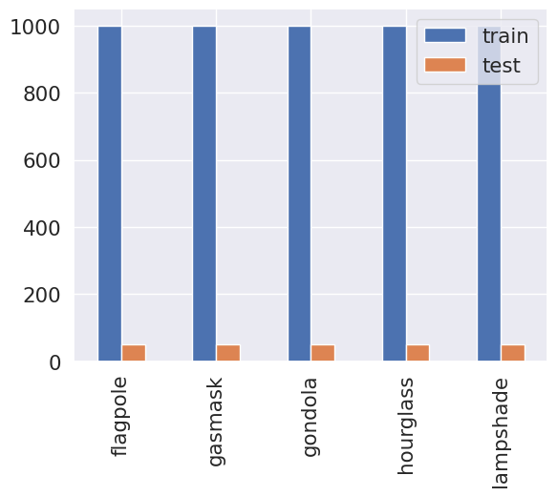
Dataset
Frequency Distribution of Classes after Augmentation

Slide 5
Performance Metric Formula
Sensitivity/Recall : True Positive / (True Positive + False Negative)
Specificity : True Negative / (True Negative + False Positive)
Positive Predictive Value (PPV)/Precision : True Positive / (True Positive + False Positive)
Negative Predictive Value (NPV) : True Negative / (True Negative + False Negative)
F Score : (2 X Precision X Recall) / (Precision + Recall)

Slide 6
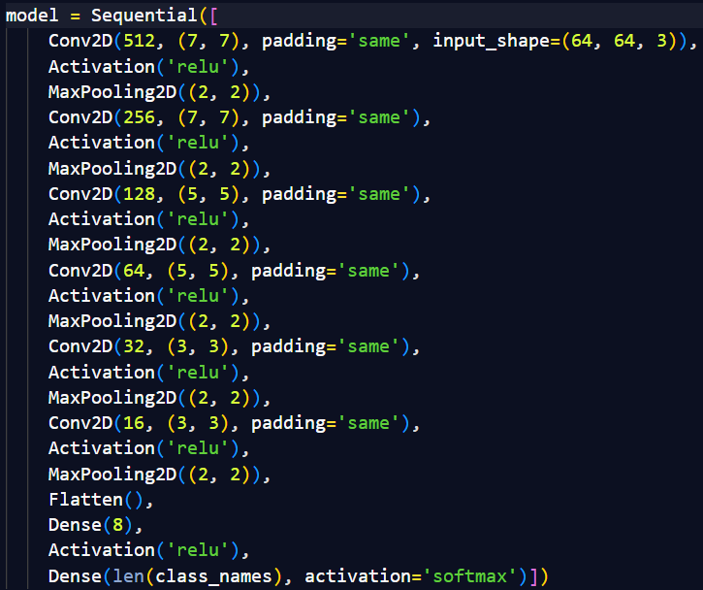
Custom CNN Code Snippet & Structure
Architecture Link @ : Custom CNN Model Figure

Slide 7
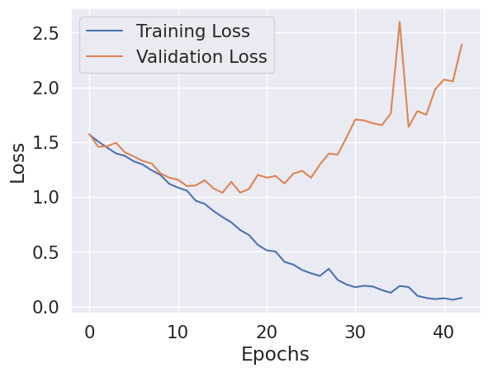
Train Vs Validation Loss for Custom CNN
Train VS Validation Loss For Custom CNN over 43/200 Epochs

Slide 8
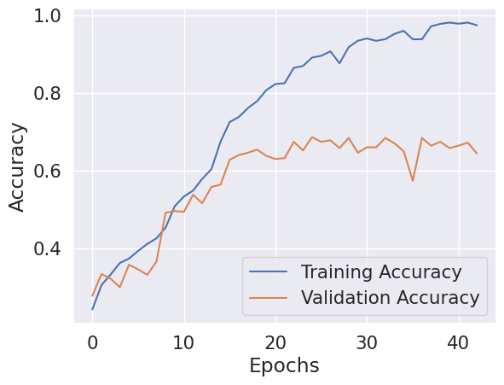
Train Vs Validation Acc. for Custom CNN
Train VS Validation Accuracy For Custom CNN over 43/200 Epochs

Slide 9
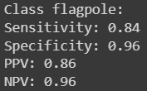
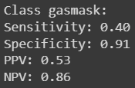
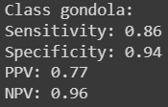
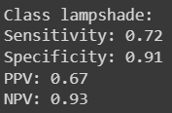
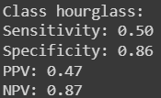
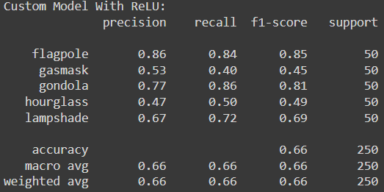
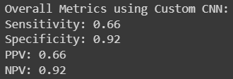
Metrics Result using Custom CNN
Individual and Overall Class Sensitivity, Specificity, PPV, NPV & Overall Accuracy using Custom CNN on Test Set

Slide 10
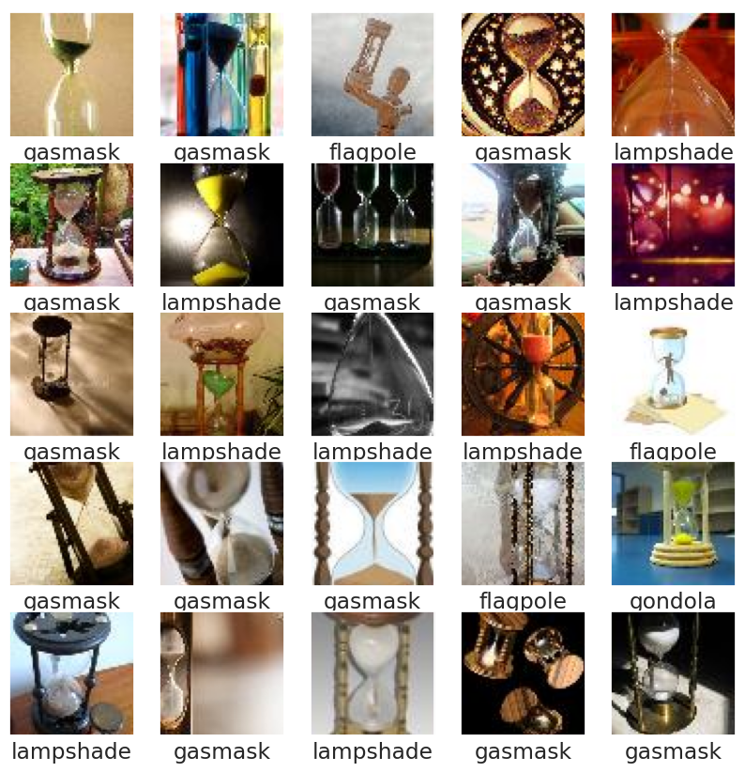
Misclassified Images using Custom CNN
Random 25 Misclassified Images in Test Set

Slide 11
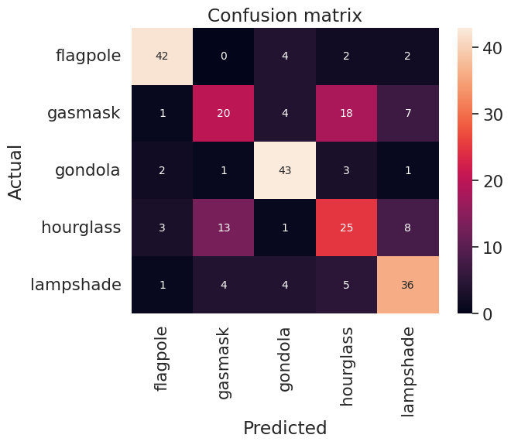
Test Confusion Matrix for Custom CNN

Slide 12
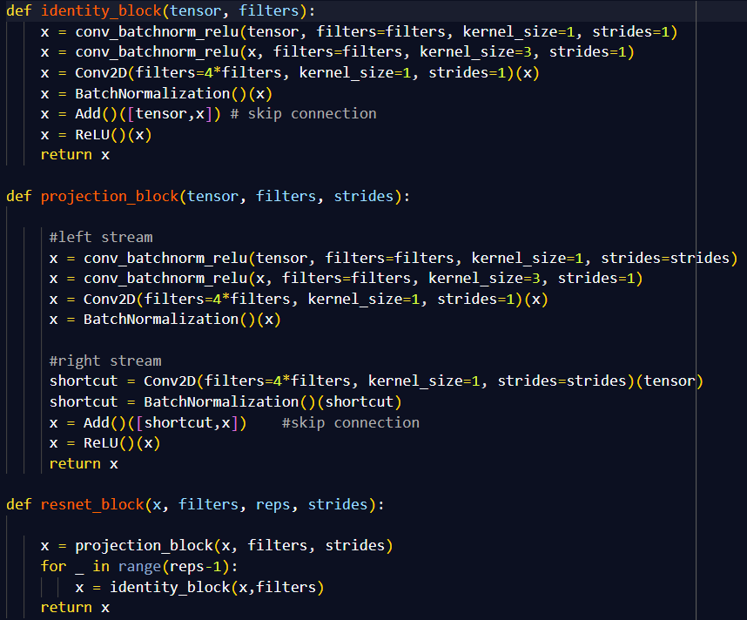
ResNet - 50 Code Snippet & Structure
Architecture Link @ : ResNet - 50 Model Figure

Slide 13
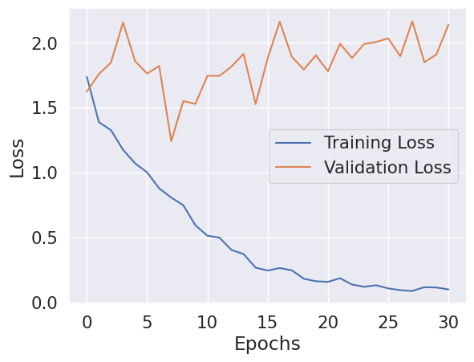
Train Vs Validation Loss for ResNet - 50
Train VS Validation Loss For ResNet - 50 over 31/200 Epochs

Slide 14
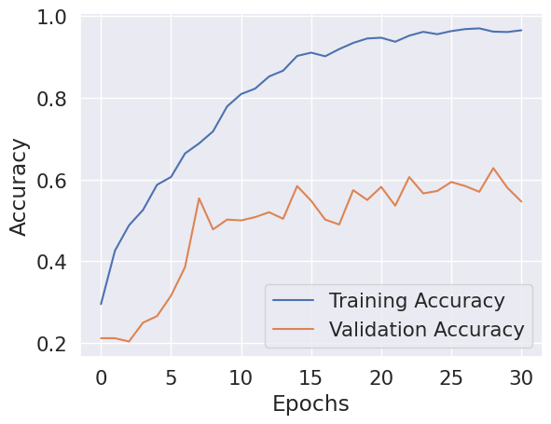
Train Vs Validation Acc. for ResNet - 50
Train VS Validation Accuracy For ResNet - 50 over 31/200 Epochs

Slide 15
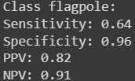
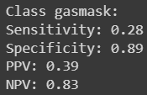
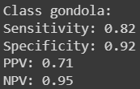
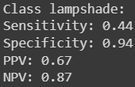
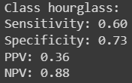
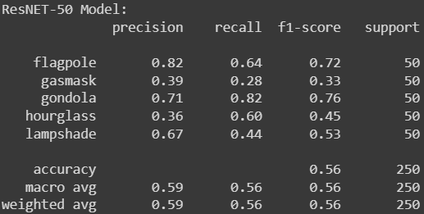
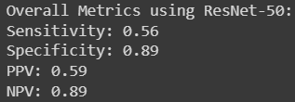
Metrics Result using ResNet - 50
Individual and Overall Class Sensitivity, Specificity, PPV, NPV & Overall Accuracy using ResNet - 50 on Test Set

Slide 16
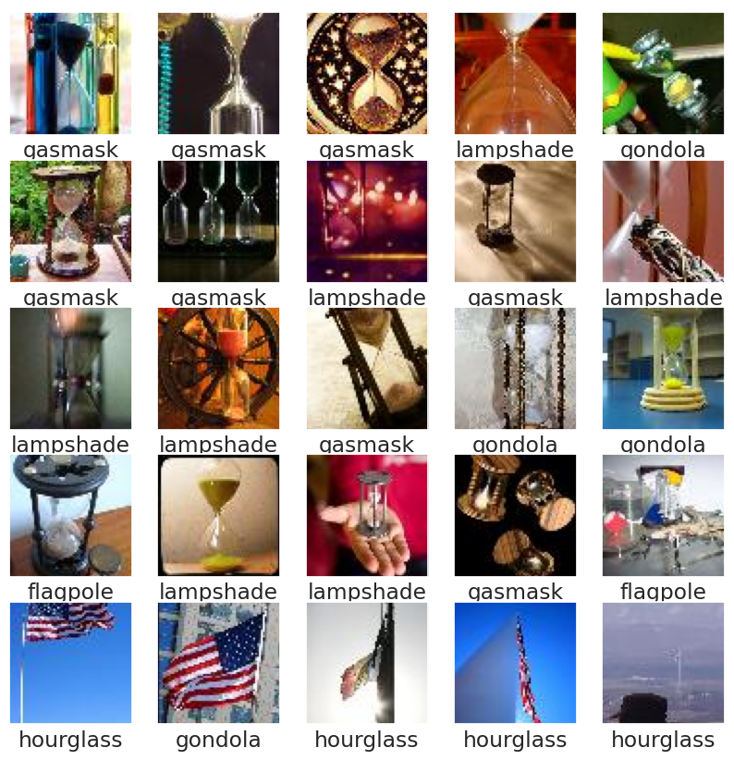
Misclassified Images using ResNet - 50
Random 25 Misclassified Images in Test Set

Slide 17
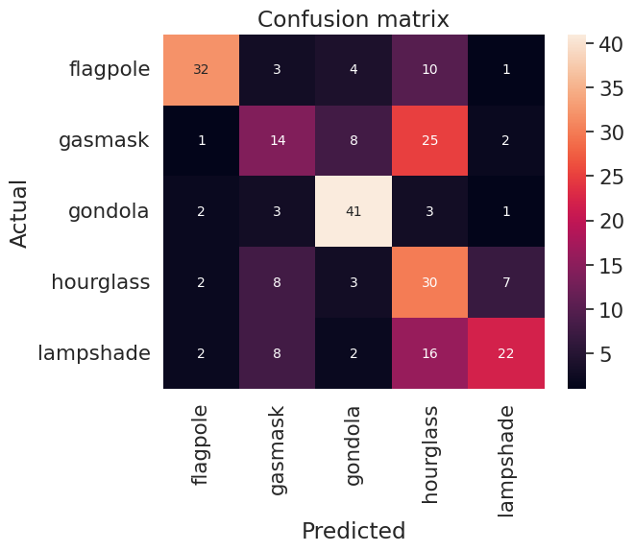
Test Confusion Matrix for ResNet - 50

Slide 18
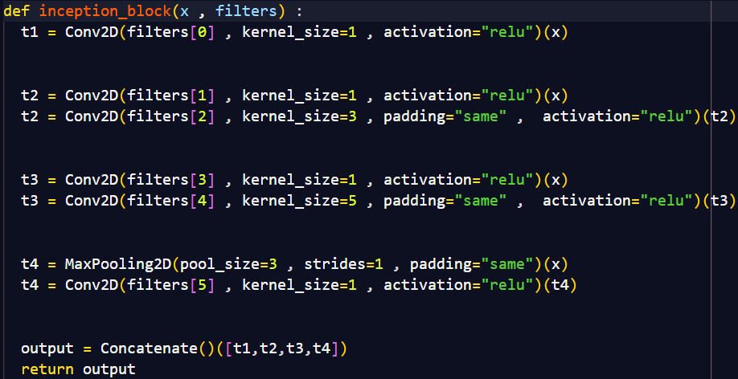
InceptionNet Code Snippet & Structure
Architecture Link @ : InceptionNET Model Figure

Slide 19
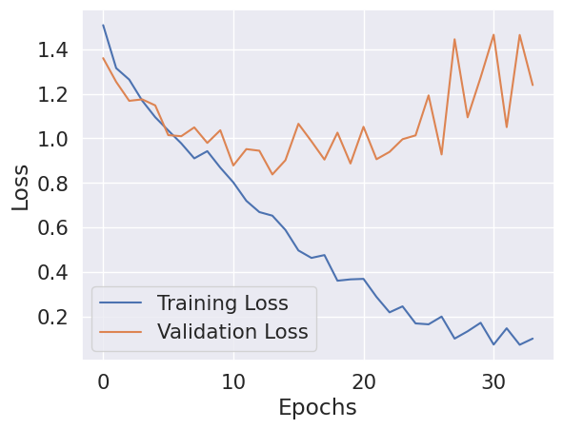
Train Vs Validation Loss for InceptionNet
Train VS Validation Loss For InceptionNET over 34/200 Epochs

Slide 20
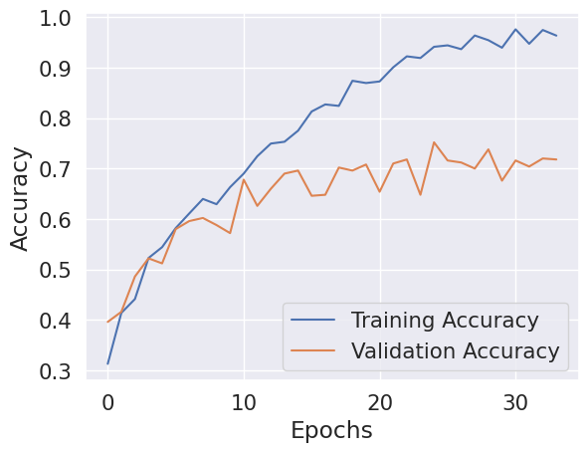
Train Vs Validation Acc. for InceptionNet
Train VS Validation Accuracy For InceptionNET over 34/200 Epochs

Slide 21
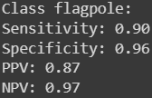
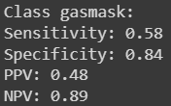
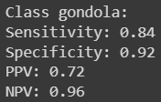
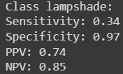
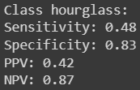
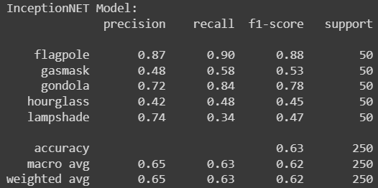
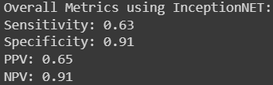
Metrics Result using InceptionNet
Individual and Overall Class Sensitivity, Specificity, PPV, NPV & Overall Accuracy using InceptionNET on Test Set

Slide 22
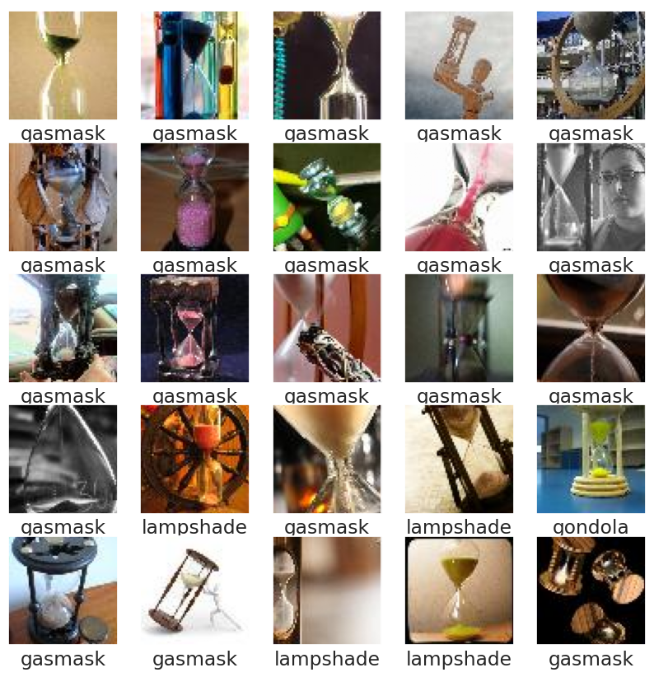
Misclassified Images using InceptionNet
Random 25 Misclassified Images in Test Set

Slide 23
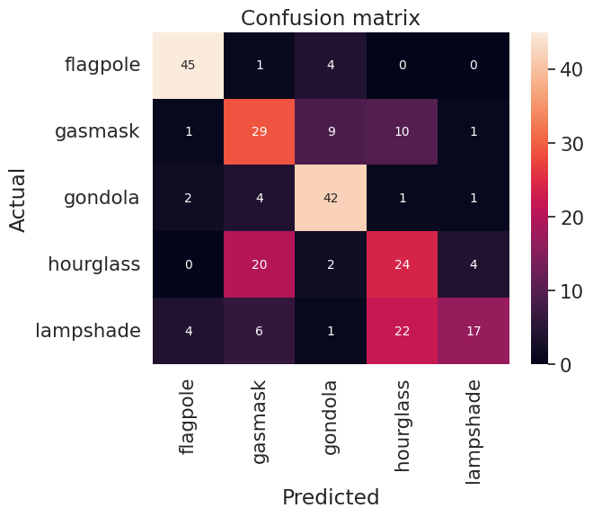
Test Confusion Matrix for InceptionNet

Slide 24
Results
Algorithm (Epochs/200) | Test Accuracy | Precision (Macro) | Recall (Macro) | F Score (Macro)
Custom CNN (43) | 66.4 | 0.66 | 0.66 | 0.66
ResNet - 50 (31) | 55.6 | 0.59 | 0.56 | 0.56
InceptionNET (34) | 62.8 | 0.65 | 0.63 | 0.62
Keras ResNet - 50 (14) | 60.8 | 0.65 | 0.61 | 0.60
Keras InceptionNET (11) | 83.6 | 0.84 | 0.84 | 0.83
Overall Accuracy (%), Precision, Recall and F1 Score using Custom CNN model, Customized ResNet - 50 & InceptionNET model, Pretrained ResNet - 50 & InceptionNET model

Slide 25
Decision
Due to Low Numbers of Train and Test Data Most of Our CNN Models Couldn’t Achieve Better Accuracy.
Our ResNet - 50, InceptionNet and Custom CNN Model has Overfitting Issue.
To Solve this Problem We Used Techniques Like:
Data Augmentation
Regularization
Hyperparameter Tuning
Bagging and Boosting
Using Pre Trained ResNet - 50 and InceptionNet Provides Better Performance on the Same Dataset Compared to Our CNN Models and It’s Variants.

Slide 26
Conclusion
Low Number of Data are Creating Overfitting Issue.
Our Custom CNN Model with ReLU Activation Gives Better Accuracy and F1 Score Compared to our ResNet - 50 and InceptionNet.
Custom CNN and It’s Variants Performed Better Compared to Previous Neural network and Logistic Models.
For the Future, Solving Overfitting Issues will Make the Model Better.

